Slide 1
Data Analytics and Visualisation

Slide 2
Download the code
git clone https://github.com/JFrusher/DCE-code-workshops.git
cd DCE-code-workshops
pip install -r requirements.txt

Slide 3

The Problem
You are an engineer hired by Spinny things Ltd to analyse turbine sensor data and help determine which of their wind turbines to do preventative maintenance on.
Notes:
Explain the context of this and the outcomes

Slide 4
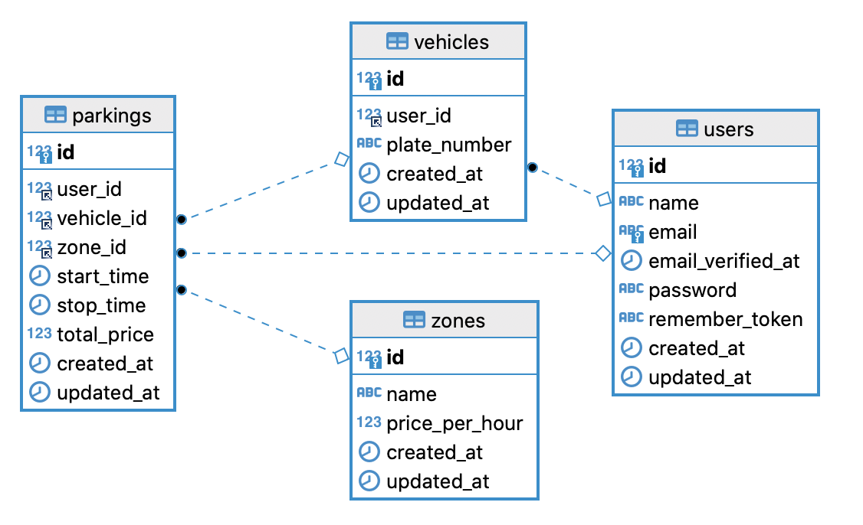
Data Ingestion and Schema Verification
Ingest time-series CSV telemetry
Audit column data types between environmental vectors and asset response indicators
Identify schema to cross examine structural shape and memory footprint
Notes:
Explain the telemetry we’ve got

Slide 5

Missing Data Handling
Telemetry dropouts are data themselves
  Dropping rows can erase evidence of asset failure
Never blindly overwrite missing values
  Create a categorical marker column to flag dropout rows
Isolate clean rows for stats
Notes:
Explain that data is real and has all these things, explain the implications of overwriting. But the need for clean rows for stats

Slide 6
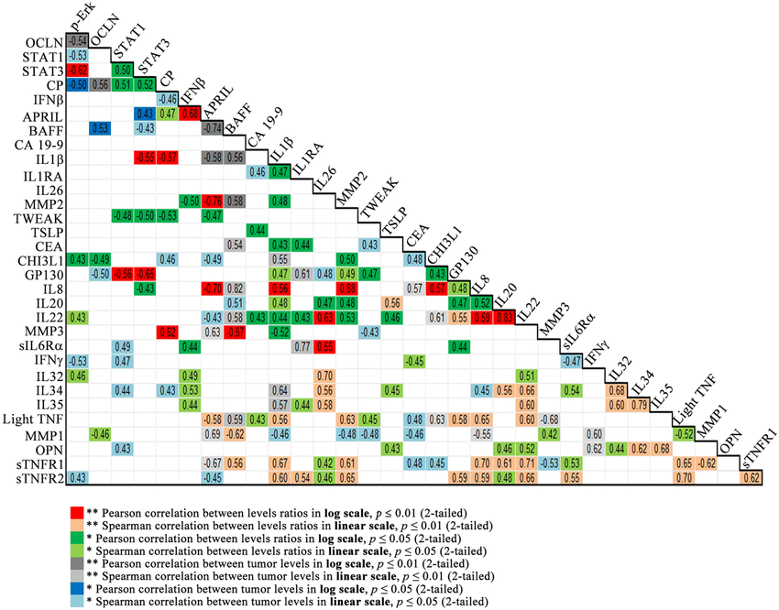
Multi-Variable Relationship Matrix
Map physics to position, colour, point sizes
Expose ambient vs operational heat etc
Use the X,Y,Z axis as well as size, colour and labels to embellish datasets
Notes:
Create engineered features and look for any statistical correlation

Slide 7
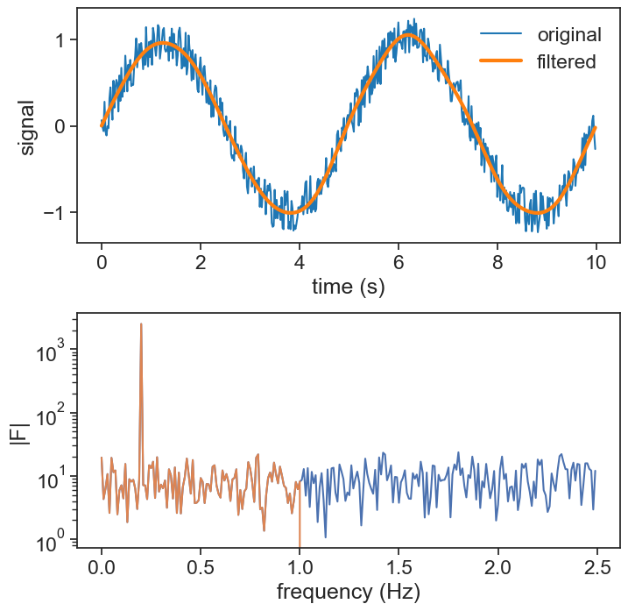
Filtering
Sensor errors can violate physical limits so we can apply physics based limits and checks
We can apply IQR based or rolling filters to steady spikes and faulty signals
We can also use Fourier transforms to apply filters to specific domains within the frequency spectrum
Notes:
Explain the Fourier spectrum and its uses to remove noise

Slide 8
Dimensionless Normalisation
High RPM naturally drives vibration
Absolute values can hide wear
Engineers a physics-informed ratio metric
Smooth local noise using rolling averages
Notes:
Talk about creating engineered features and normalisation to make things comparable such as vibration may go up but it stays proportional to rpm so might actually be safe

Slide 9
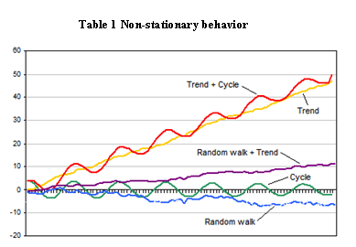
Isolating Drift via Linear Modelling
Fit mathematical lines to time-series
Extract slope as degradation speed
Set up a time offset index to serve as an independent variable for trend fitting
Notes:
Acknowledge drift and account for it, allow variation but normalise long term drift

Slide 10
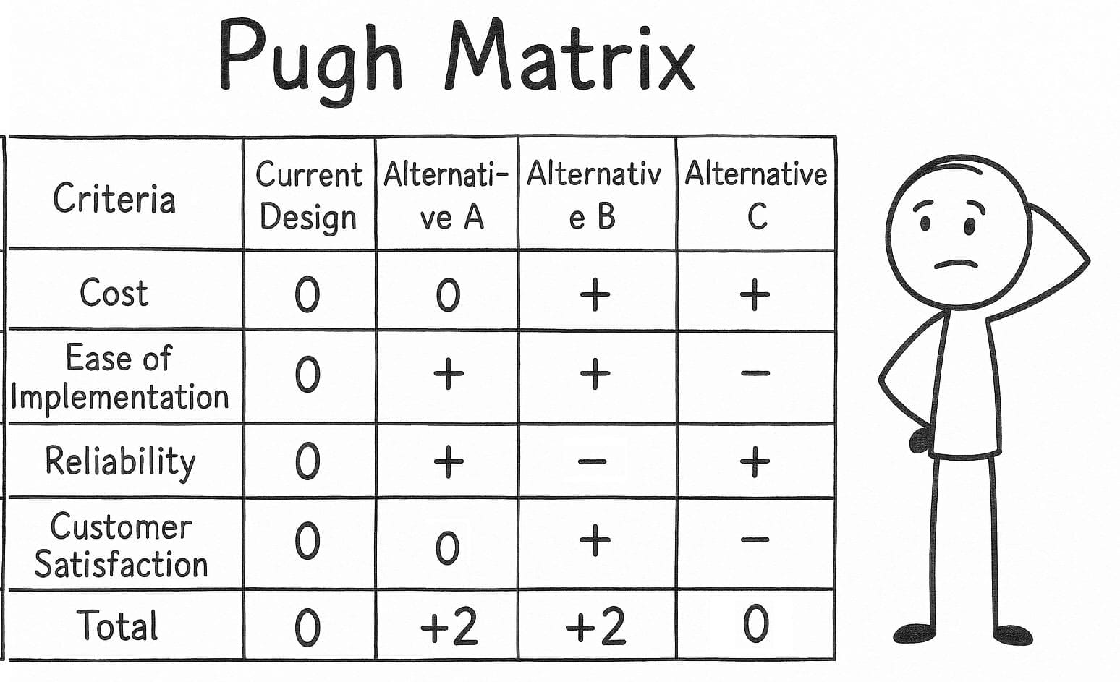
Algorithmic Accountability and Decision Matrix
Data-centric traceability
Consider tradeoffs – cost, delays, impact of failure, etc
Decisions sometimes involve factors that can’t be parametrised
Notes:
Rate algorithmic solutions and understand tradeoffs etc, interactive get examples

Slide 11
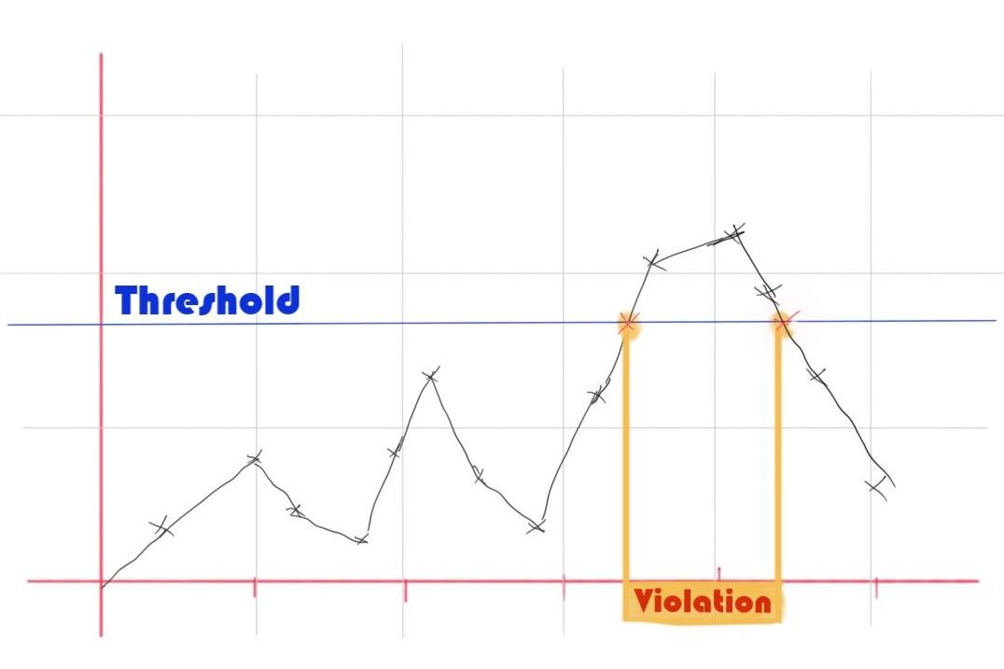
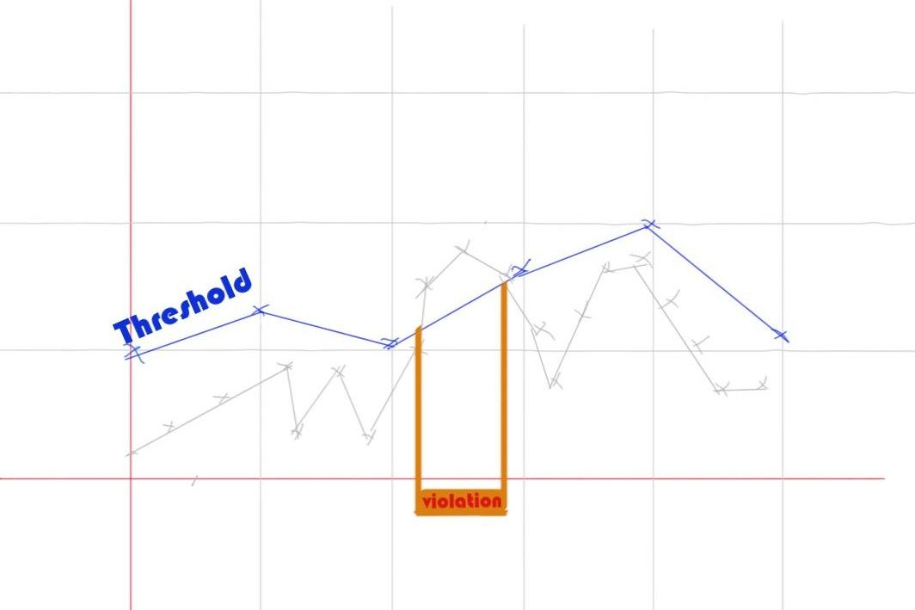
Risk-Based Thresholds
Define normal via healthy baselines
Establish statistical alert boundaries
Ensure thresholds are physics driven and are auditable in their placement
Notes:
A risk-based threshold gives professional liability to the engineer that signed off on it, auditability, get examples

Slide 12
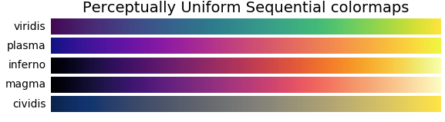
Accessibility
Colour vision deficiency affects 11% of the population
Ensure colour doesn’t do the work in differentiating your plots, think of marker shapes, line style, labelling etc
Don’t clutter graphs with unnecessary lines
Notes:
4.5% of the population, best practice and also helps with B/W printing

Slide 13
Broad Accessibility & Ethics
Ensure your charts are honest, clear and accessible.
Keep the signal to noise ratio high in your design
Provide helpful alt text to all images, charts and slides etc
Notes:
Get examples in for this too

Slide 14


